Slide 1
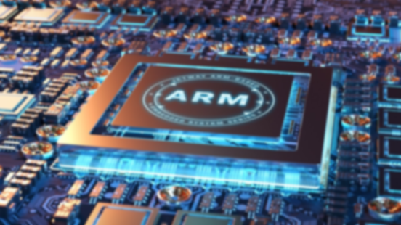
Embedded System Design(EEL 7150) PROJECT
Course Instructor : Dr. Deepak Fulwani
KARAN BHAKUNI - M22RM003
RAHUL MADAAN – M22RM008

Slide 2

ADAPTIVE BRIGHTNESS CONTROL USING LDR(Light Dependent Resistor) SENSOR
ON STM32F412 NUCELO BOARD

Slide 3
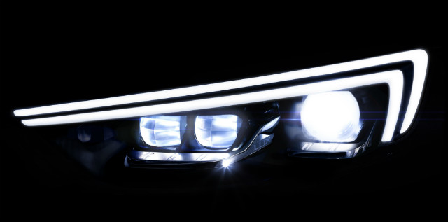
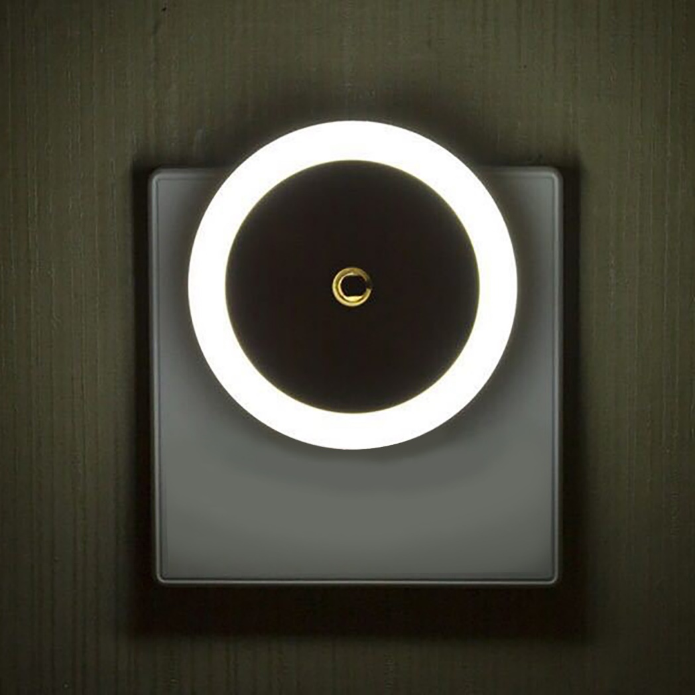
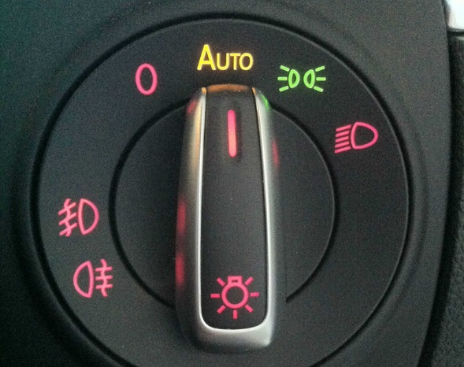
HOME APPLIANCES
Ref: Wikipedia images

Slide 4
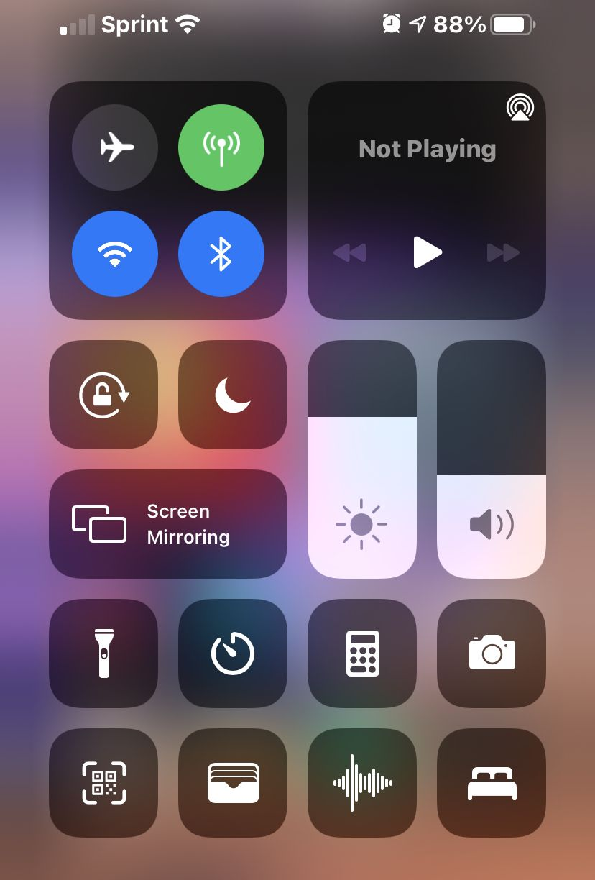
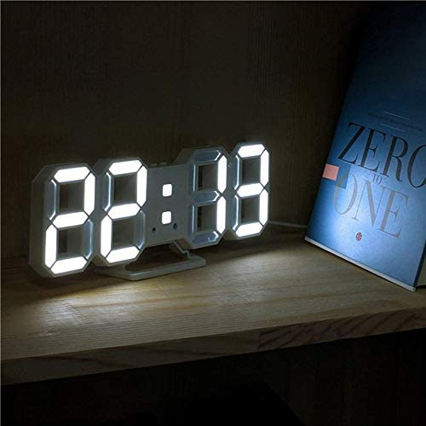
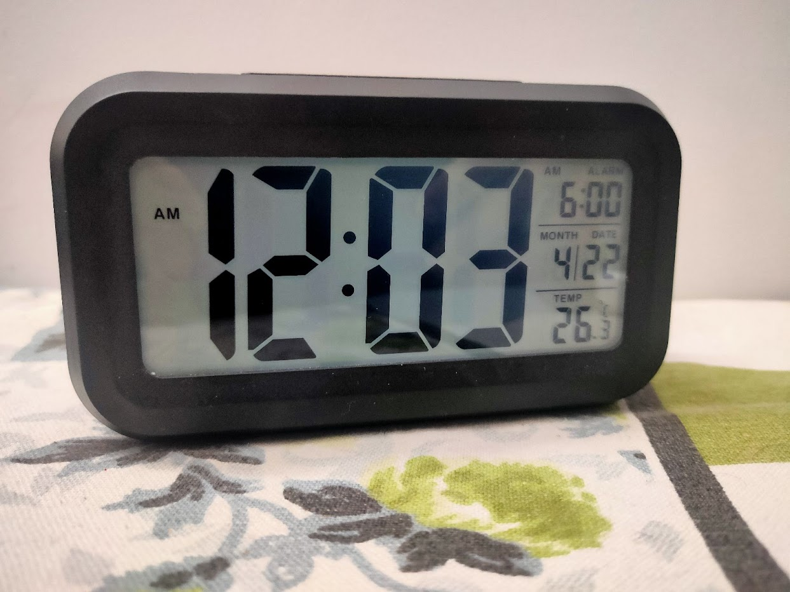
Intensity Based:
Ambient light sensor
Ref: Wikipedia images

Slide 5
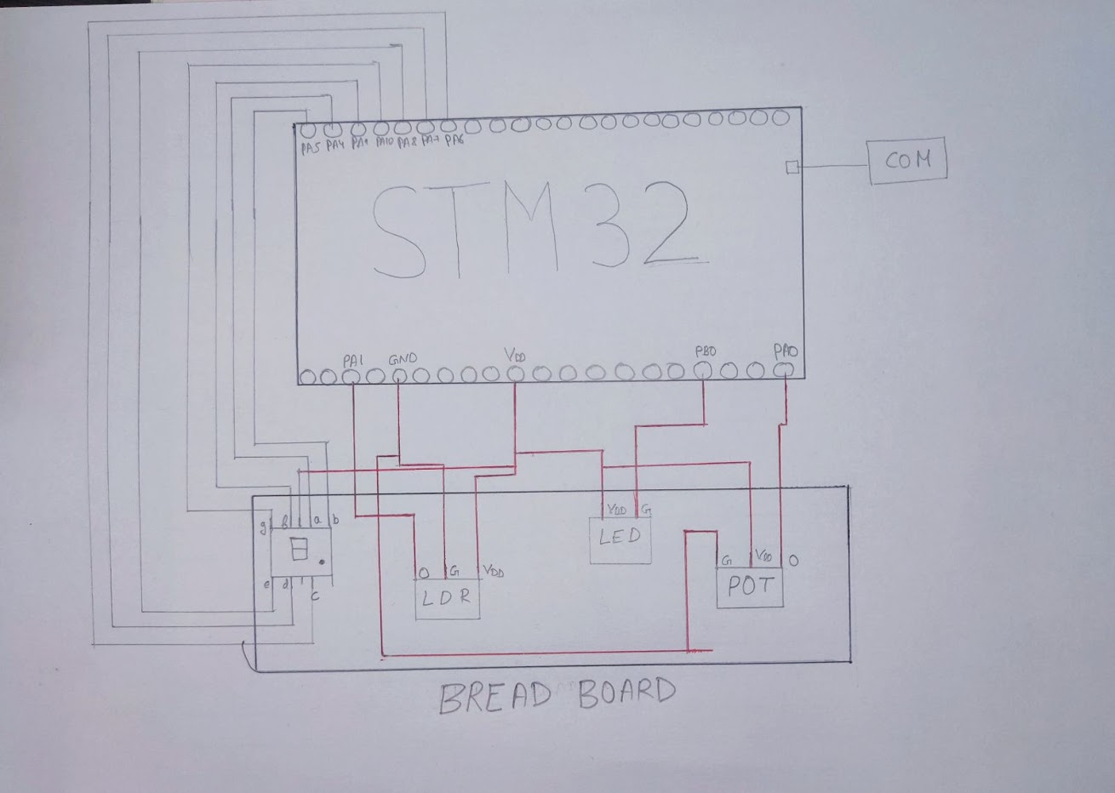
Circuit Diagram

Slide 6
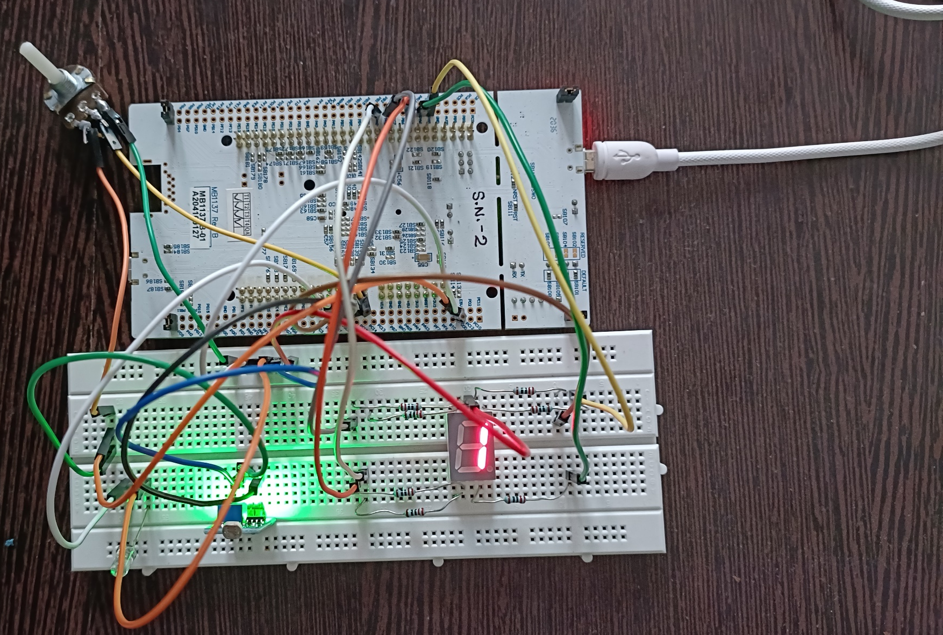
SETUP

Slide 7
Method-1
Initializing the Header file
Configuring the Clocks and MODER register
While(1)
If voltage is detected
Y
N
LED ON
LED OFF

Slide 8
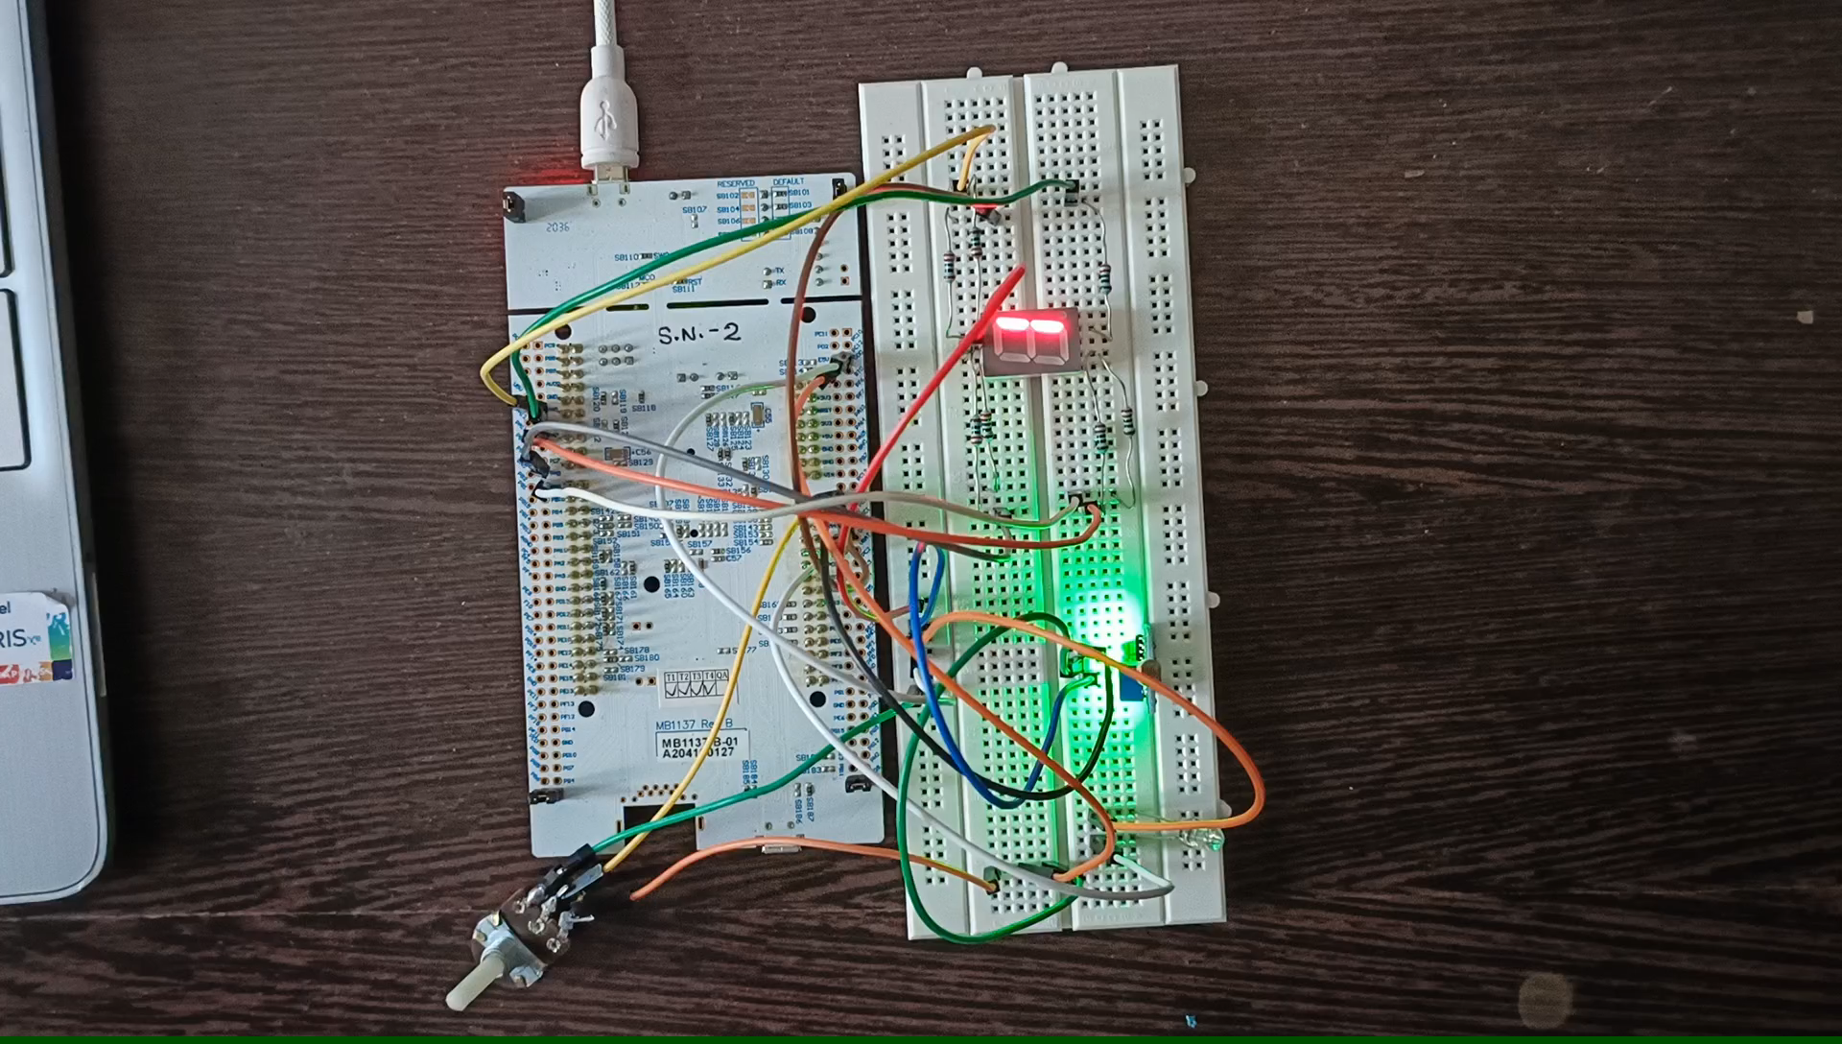

Slide 9
Method-2
num_steps = FADE_TIME / DELAY_TIME; calculates the number of fade steps required to complete the entire fade duration. In this case, num_steps would be 100
step_delay = FADE_TIME / num_steps; calculates the duration of each fade step. In this case, step_delay would be 20
If voltage is detected
Y
for (int i = 0; i < num_steps; i++)
duty_cycle = ((i + 1) * 100) / num_steps;
delay = duty_cycle * step_delay / 100
off_delay = step_delay - delay
LED ON
LED OFF

Slide 10
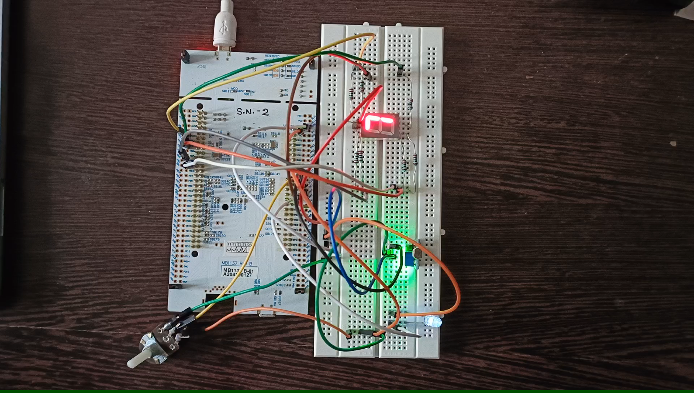

Slide 11
Method-3
Initializing the Header file
Configuring the Clocks (ADC1)and MODER register
Enable continuous conversion mode, EOC after each conversion ,enable ADC conversion in regular sequence
While(1)
clear the status register
starting conversion by SWSTART
Checking until conversion completes
if((ADC1->SR & (0x2)))

Slide 12
While(1)
clear the status register
starting conversion by SWSTART
Checking until conversion completes
if((ADC1->SR & (0x2)))
duty_cycle=adc_value/80
delay = duty_cycle
off_delay = 100 - delay
LED ON
LED OFF

Slide 13
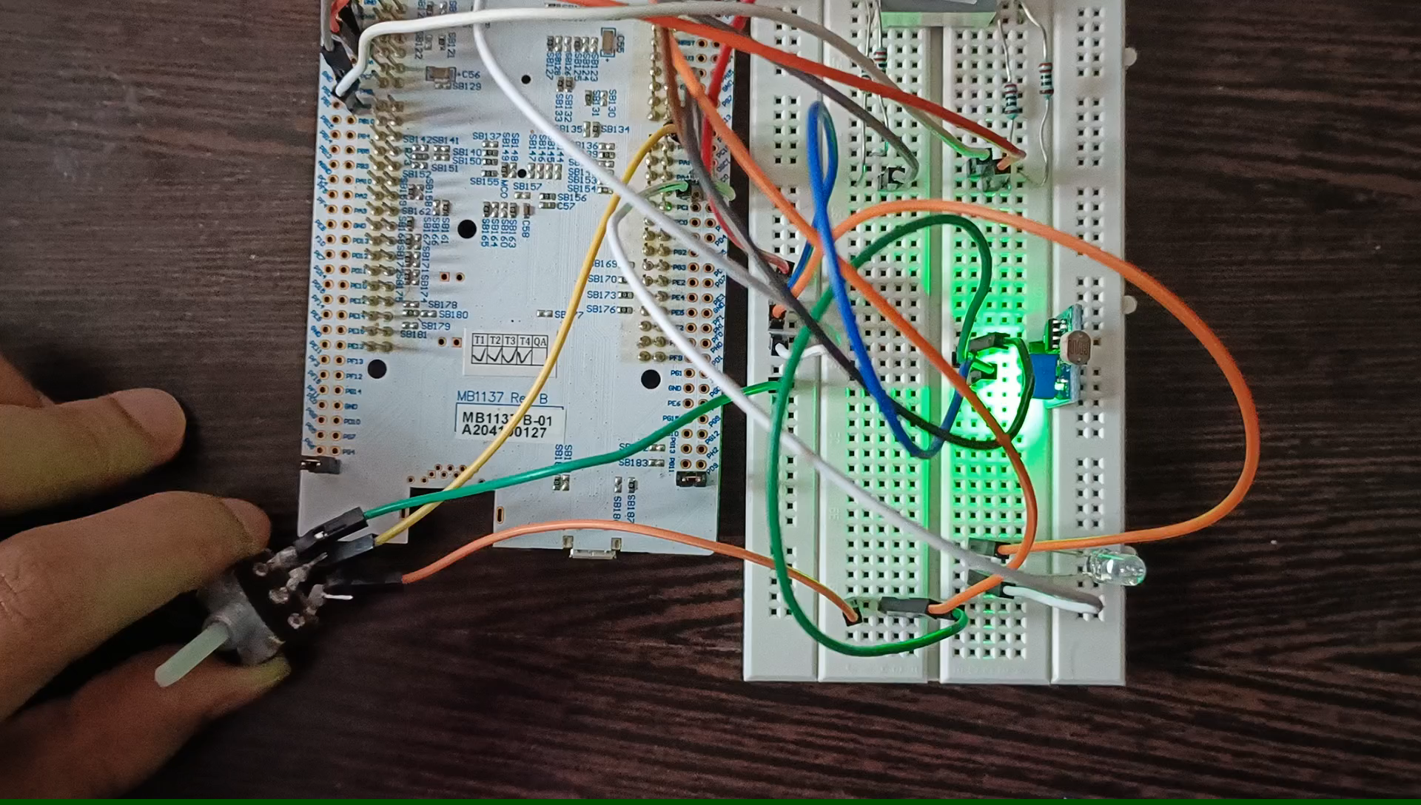

Slide 14
Improvements and Future Work
1.We can also integrate LDR sensor with Analog Output and directly map it to change brightness of LED.
2. We can also integrate LCD screen to show the brightness percentage on it.

Slide 15
References
1.Datasheet, Reference Manual and Board Schematic of STM32F412 nucleo board.
2.Embedded Systems with ARM Cortex-M Microcontrollers in Assembly Language and C. By Dr. Yifeng Zhu.

Slide 16
Any Questions?
THANK YOU!

